Slide 1
15 Words Interpreted Differently in Chicago
Adapted from
http://www.buzzfeed.com/laraparker/words-that-have-a-different-meaning-that-have-a-different#.xdXxmwdNp
By Laura Parker

Slide 2
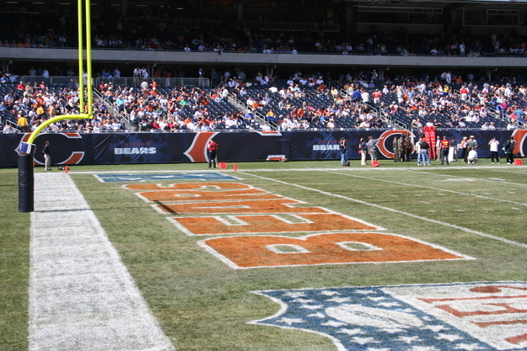
1. Soldier
Source: Flickr: dgphilli / Creative Commons / Via Flickr: 75811596@N00

Slide 3
2. Coach
Source: Flickr: MacQ / Creative Commons / Via Flickr: 60455521@N00

Slide 4
3. The L
Source: Via transitchicago.com

Slide 5
4. Winter
Source: Via imgur.com

Slide 6
5. Boot
Source: Flickr: Corey Wagehoft / Creative Commons / Via Flickr: 47631699@N00

Slide 7
6. Dibs
Source: Flickr: William Selman / Creative Commons / Via Flickr: 81358982@N00

Slide 8
7. Shorts Weather
Source: gelferstone.com

Slide 9
8. Time Zone
Source: Wikimedia Commons

Slide 10
9. The Region
Source: Wikimedia Commons (cropped)

Slide 11
10. Pizza
Source: Flickr: agude / Via Creative Commons

Slide 12
11. The Bean
Source: Flickr: Dan / Creative Commons / Via Flickr: 64026637@N02

Slide 13
12. The Beach
Source: Flickr: Thiago Cavazzana / Creative Commons / Via Flickr: 69947719@N00

Slide 14
13. Cheese
Source: packertime.com

Slide 15
14. April
Flickr: KK / Creative Commons / Via Flickr: 14131943@N00

Slide 16
15. The Second City
Source: Flickr: Edward Stojakovic / Creative Commons / Via Flickr: 26736723@N00

