Slide 1
15 Words Interpreted Differently in Southern Indiana
Adapted from http://www.movoto.com/in/indiana-words/
by Spencer McKee

Slide 2
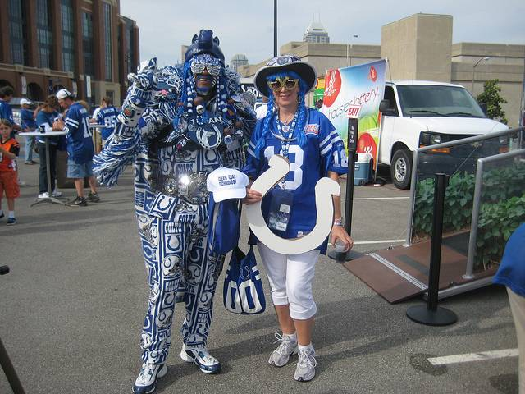
1. Colts
Source: Flickr User americaspower

Slide 3
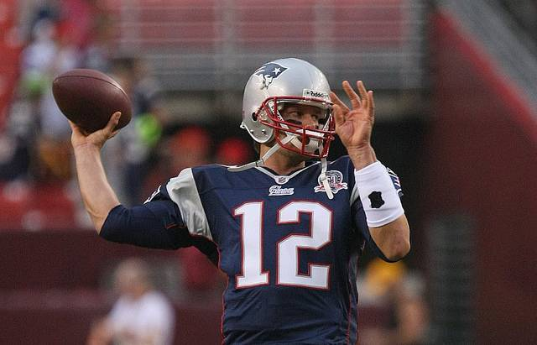
2. Patriots
Source: Flickr User Keith Allison

Slide 4
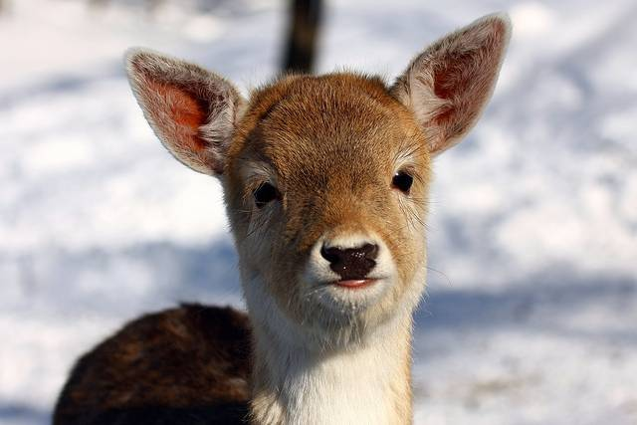
3. Deer
Source: Flickr User Martin Cathrae

Slide 5
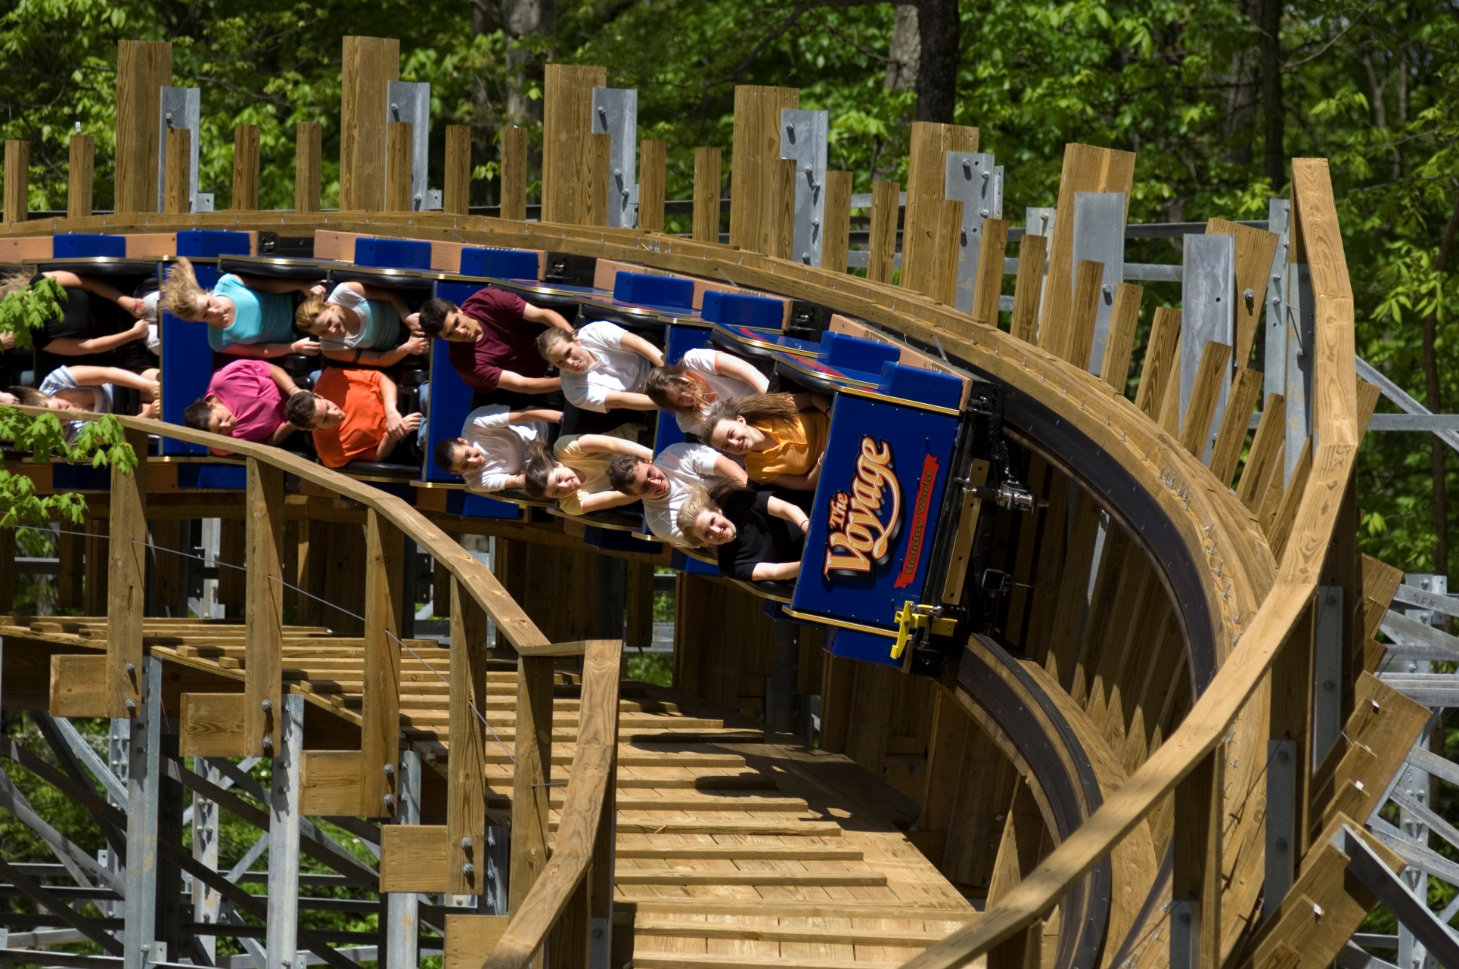
4. Santa Claus
Source: HolidayWorld.com

Slide 6
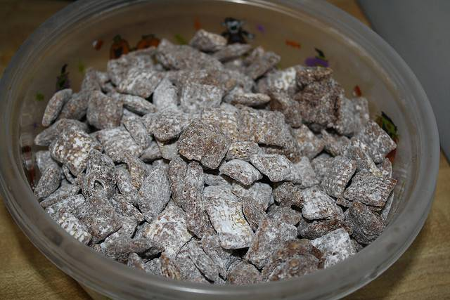
5. Puppy Chow
Source: Flickr User Kara Michele

Slide 7
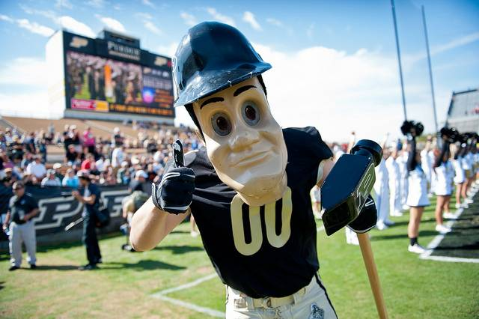
6. Boilermaker
Source: Flickr User TownePostNetwork

Slide 8
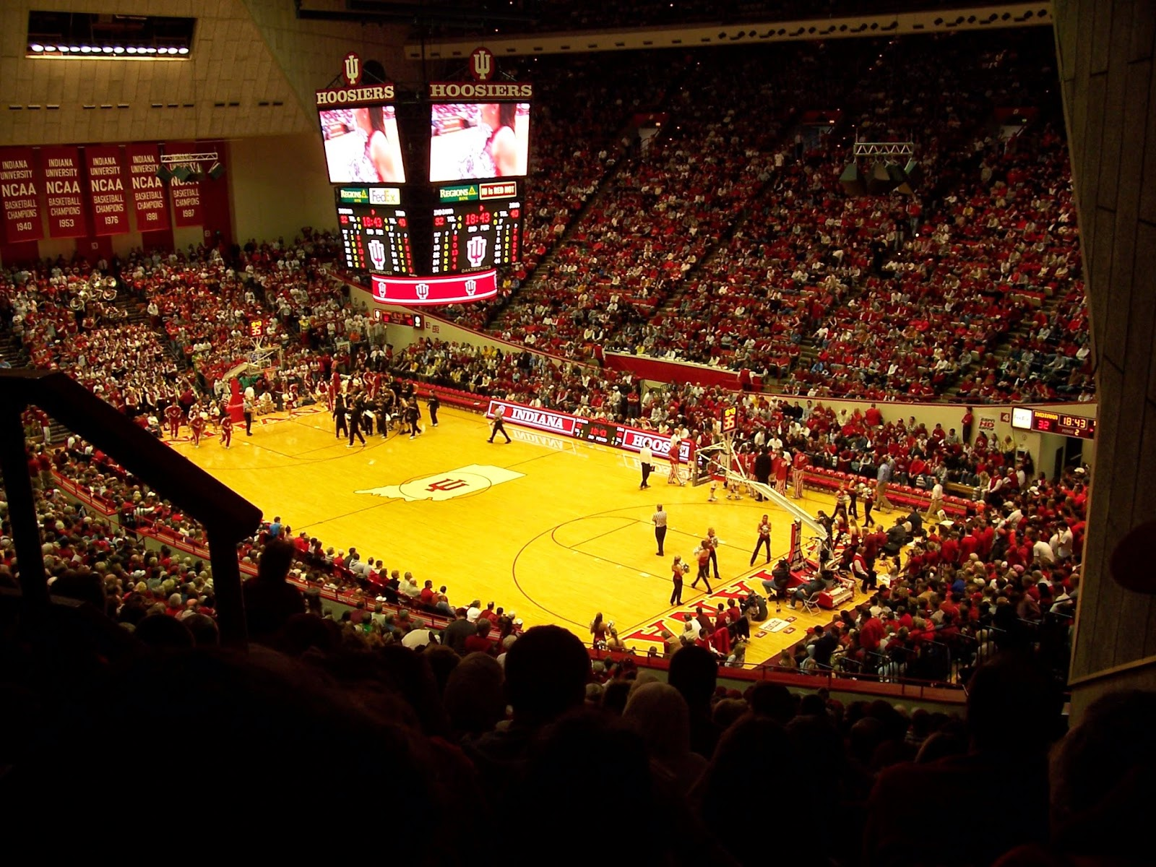
7. Hoosier
Source: ncaabballchamps.blogspot.com

Slide 9
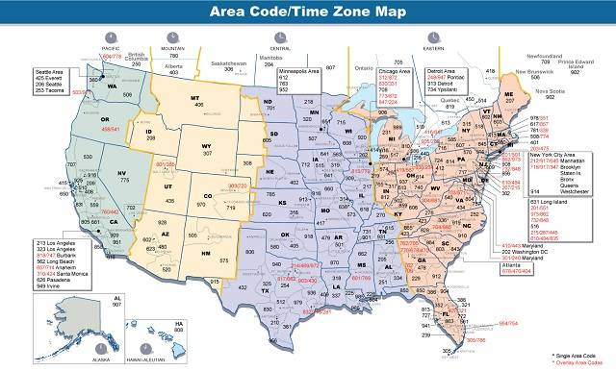
8. Time Zone
Source: Wikimedia Commons

Slide 10
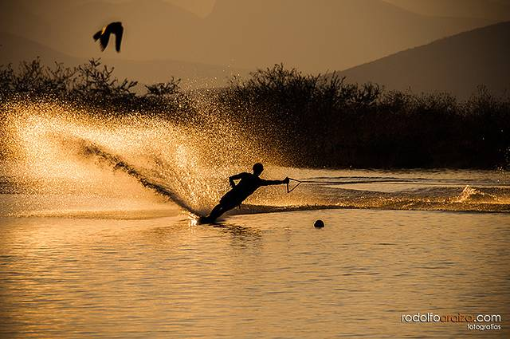
9. Ski
Source: Flickr User rodolfoaraiza

Slide 11
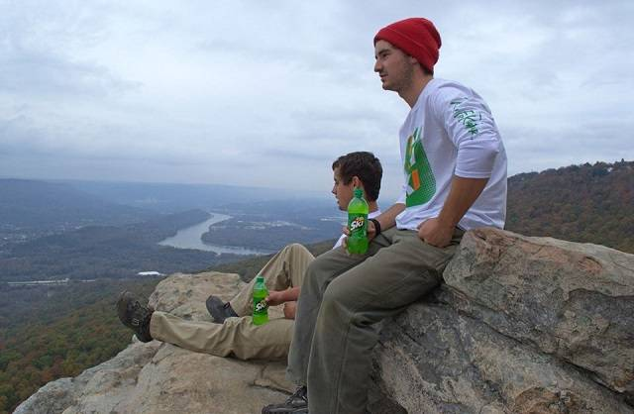
10. Ski
Source: Flickr User rodolfoaraiza

Slide 12
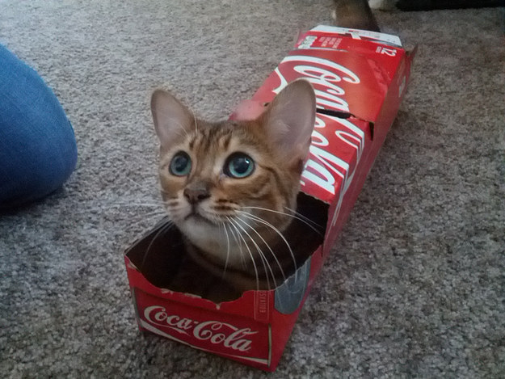
11. Pop
Source: Via imgur.com

Slide 13
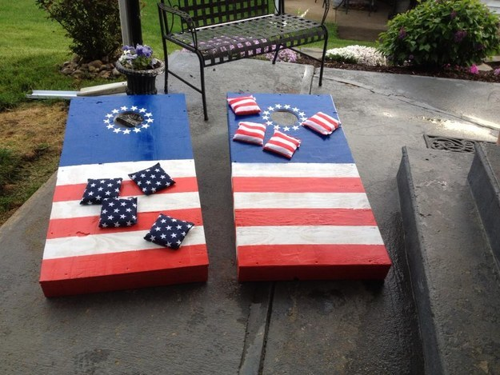
12. Cornhole
Source: Via imgur.com

Slide 14
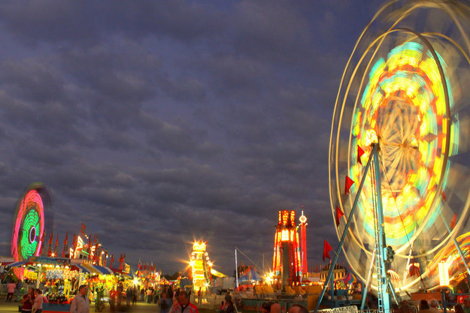
13. Fair
Source: Flickr: brent_nashville / Via Creative Commons

Slide 15
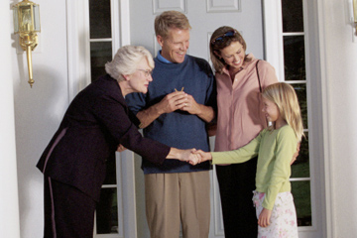
14. Manners
Source: www.lifestyle.howstuffworks.com

Slide 16
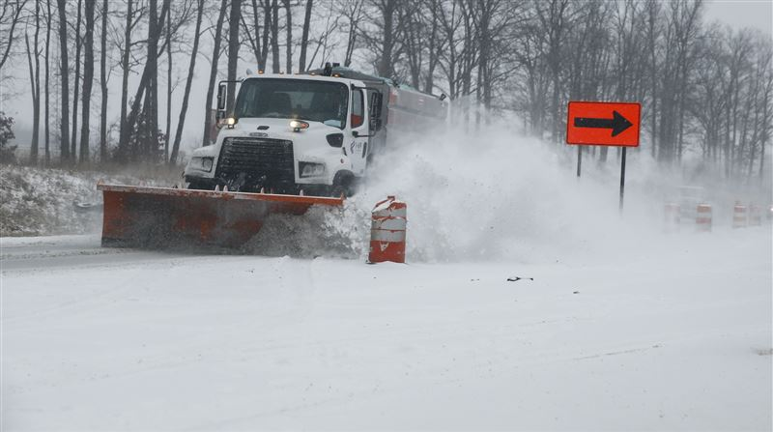
15. Weather
Source: elkharttruth.com

