Slide 1
Nadine Gilkison www.SmekensEducation.com

Slide 2
to make clear

Slide 3
to find a way things are alike

Slide 4
to fill in;
to finish

Slide 5
text surrounding a word or passage; helps explain a word’s full meaning

Slide 6
to tell about or
write about,
paint a picture with words

Slide 7
to decide something;
find out something

Slide 8
to add details; to expand

Slide 9
to judge and tell the good and the bad; to decide the value or amount of

Slide 10
teach me or show me; tell me the steps; to make clear or understandable

Slide 11
a truth, something that can be proved

Slide 12
create or put together

Slide 13
to give examples or explain and make clear

Slide 14
to guess based on information; find the hidden meaning; to make a decision about the information

Slide 15
to show how something is just or correct; to prove

Slide 16
to leave out

Slide 17
a list of main points

Slide 18
to try to get another person to think or feel the same way you do

Slide 19
to change or improve something

Slide 20
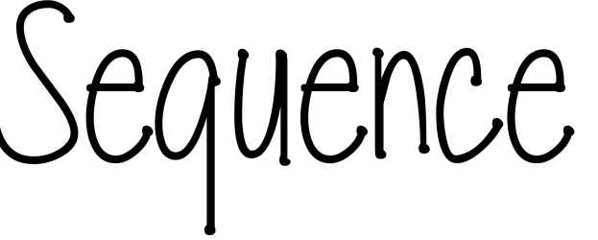
the following of one thing after another; the order of events or steps

Slide 21
to tell the main idea; the beginning, middle or end

Slide 22
to back it up or prove with details

