Slide 1
created with evidence
from the following text
By: Rachael Gilkison

Slide 2
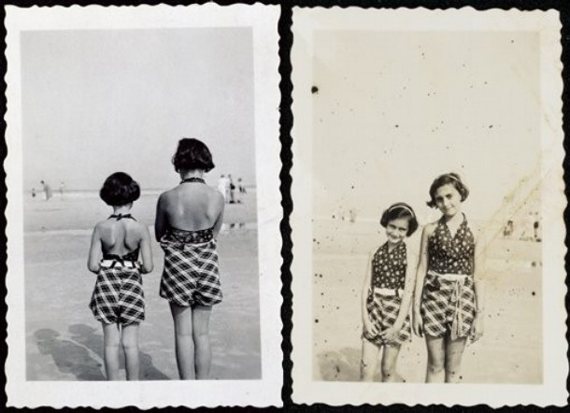
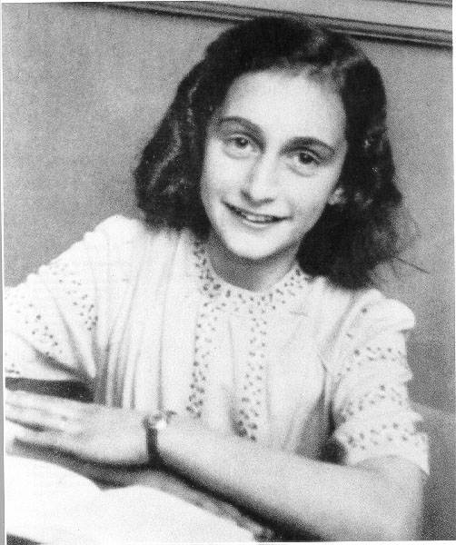
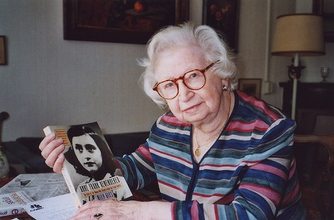
In the beginning, Anne’s life was full of normal activities; visits to the beach, movies, and school.

Slide 3
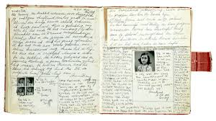
On her 13th birthday, Anne received a diary from her father, Otto Frank. She hoped to become a famous writer someday.

Slide 4
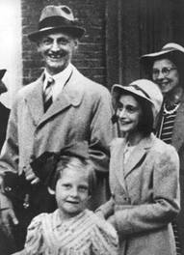
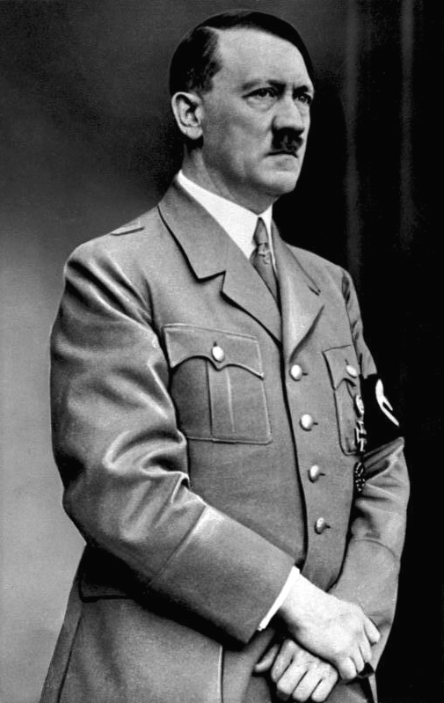
When Adolf Hitler came to power in Germany, life for Jews became unbearable. He eventually banished them to concentration camps of unbelievable conditions.
Otto Frank planned a secret hiding place for his family within his office building to protect them from the Nazis.

Slide 5
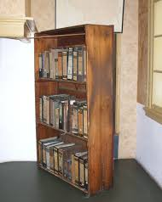
The “Secret Annex” was equipped with a false bookcase to hide its identity. Otto even made room for several families to join them as well.

Slide 6
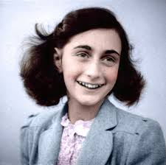
Miep Geis, a valuable asset to the Frank family, provides food and other supplies for their survival.
The Frank family was eventually discovered with Otto Frank as the lone survivor, but thanks to Miep, Anne’s diary was rescued.
Anne has achieved her goal of becoming a famous writer with over 6 million copies of her diary being published.

