Slide 1
My Digital Vocabulary Notebook
Created by:
Write your name here

Slide 2
Vocabulary List Based on the Oxford 3,000
List your words here

Slide 3
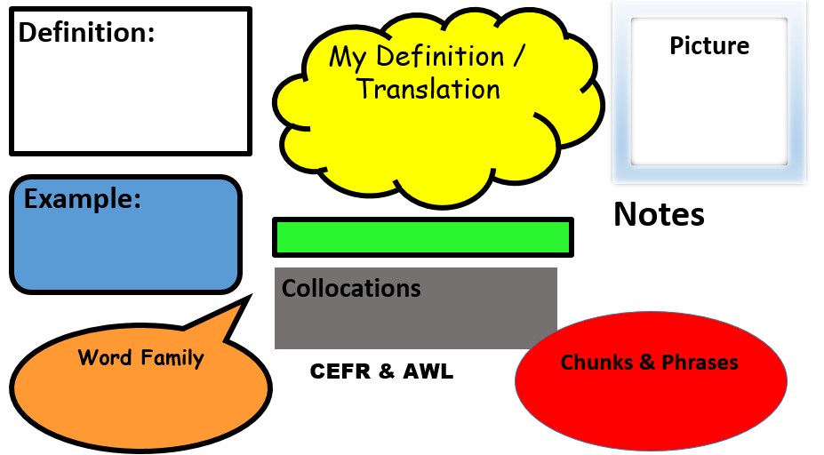
Type the dictionary definition or definitions here.
Insert a picture here.
Translate this word here or use your own words to explain it.
Copy an example or examples here.
Type the word or phrase here.
Write your own sentence using this word. Add any relevant info or links.
Type any collocations here.
Verbs, nouns, adverbs, adjectives, antonyms, synonyms etc.
Chunks, idioms and phrases.
CEFR Level?
AWL Sublist?

