Slide 1
Replace image with your picture, then delete box.
Created by:
Type Name here.

Slide 2
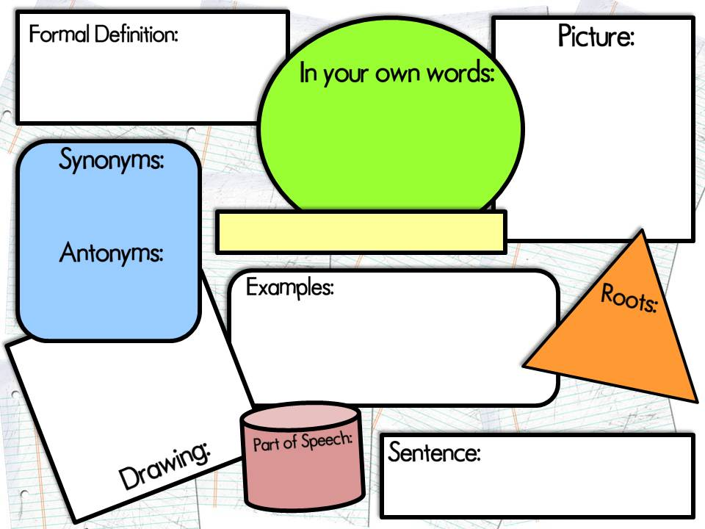
Type definition in this box.
Insert picture here.
Type definition in your own words.
Back to Vocabulary
Cover
List here.
Type Vocabulary Word Here
List here.
Type examples in this box.
Type Greek and Latin Roots here.
Insert drawing here.
List all parts of speech that apply.
Type your own sentence applying knowledge of the vocabulary word.

