Slide 1
Who is a WRITER?
© 2018 Smekens Education Solutions, Inc.
Idea by:
Suzi Wagner,
Liberty Elementary School (Danville, IL)
NOT A RIDER!

Slide 2
This is writing.
© 2018 Smekens Education Solutions, Inc.

Slide 3
This is a writer.
© 2018 Smekens Education Solutions, Inc.

Slide 4
This is writing.
© 2018 Smekens Education Solutions, Inc.

Slide 5
These are writers.
© 2018 Smekens Education Solutions, Inc.

Slide 6
This is riding.
STOP!
© 2018 Smekens Education Solutions, Inc.

Slide 7
This is a writer.
© 2018 Smekens Education Solutions, Inc.

Slide 8
This is writing.
© 2018 Smekens Education Solutions, Inc.

Slide 9
This is a writer.
© 2018 Smekens Education Solutions, Inc.

Slide 10
These are writers.
© 2018 Smekens Education Solutions, Inc.

Slide 11
This is riding.
STOP!
© 2018 Smekens Education Solutions, Inc.

Slide 12
This is a writer.
© 2018 Smekens Education Solutions, Inc.

Slide 13
They are writing.
© 2018 Smekens Education Solutions, Inc.

Slide 14
She is writing.
© 2018 Smekens Education Solutions, Inc.

Slide 15
This is writing.
© 2018 Smekens Education Solutions, Inc.

Slide 16
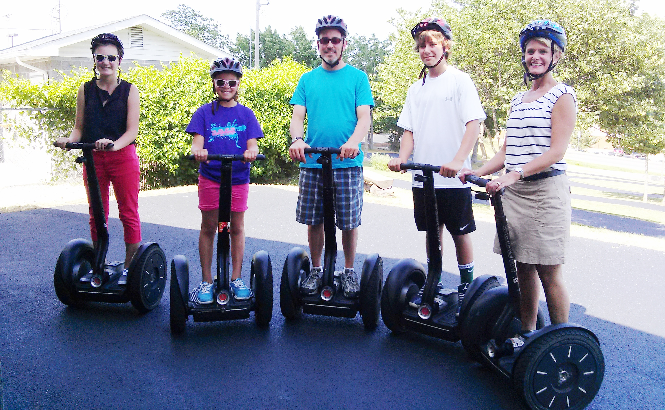
This is riding.
STOP!
© 2018 Smekens Education Solutions, Inc.

Slide 17
They are writers.
© 2018 Smekens Education Solutions, Inc.

Slide 18
They are writers.
© 2018 Smekens Education Solutions, Inc.

Slide 19
She is a writer.
© 2018 Smekens Education Solutions, Inc.

Slide 20
This is riding.
STOP!
© 2018 Smekens Education Solutions, Inc.

Slide 21
This is writing.
© 2018 Smekens Education Solutions, Inc.

Slide 22
They are writing.
© 2018 Smekens Education Solutions, Inc.

Slide 23
This is a writer.
© 2018 Smekens Education Solutions, Inc.

Slide 24
We are writers!
© 2018 Smekens Education Solutions, Inc.

